Slide 4
What is Spring Boot ?
Spring Boot is a combination of two words “Spring” and “Boot”. Here, the word ‘Spring’ represents a Spring Application. The word ‘Boot’ represents bootstrap. Hence, Spring Boot is an open-source java-based framework that helps in bootstrapping the Spring Application.

Slide 5
What is Spring Boot ?
Spring Boot is the combination of Spring Framework and Embedded Servers.
In Spring Boot, there is no requirement for XML configuration (deployment descriptor). It uses convention over configuration software design paradigm that means it decreases the effort of the developer.

Slide 6
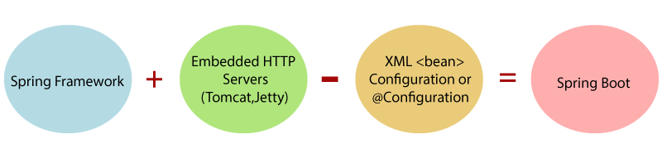
What is Spring Boot ?

Slide 7
The main goal of Spring Boot Framework is to reduce Development, Unit Test and Integration Test time and to ease the development of Production ready web applications very easily compared to existing Spring Framework, which really takes more time.
To avoid XML Configuration completely
To avoid defining more Annotation Configuration(It combined some existing Spring Framework Annotations to a simple and single Annotation)
To avoid writing lots of import statements
To provide some defaults to quick start new projects within no time.
To provide Opinionated Development approach.
By providing or avoiding these things, Spring Boot Framework reduces Development time, Developer Effort and increases productivity.

Slide 8
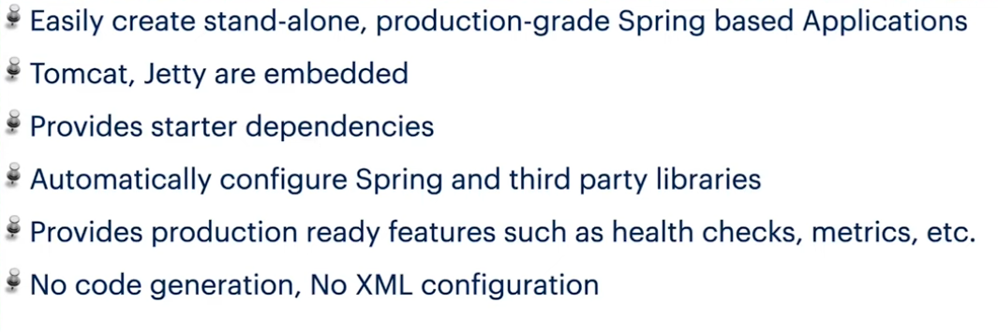

Slide 9
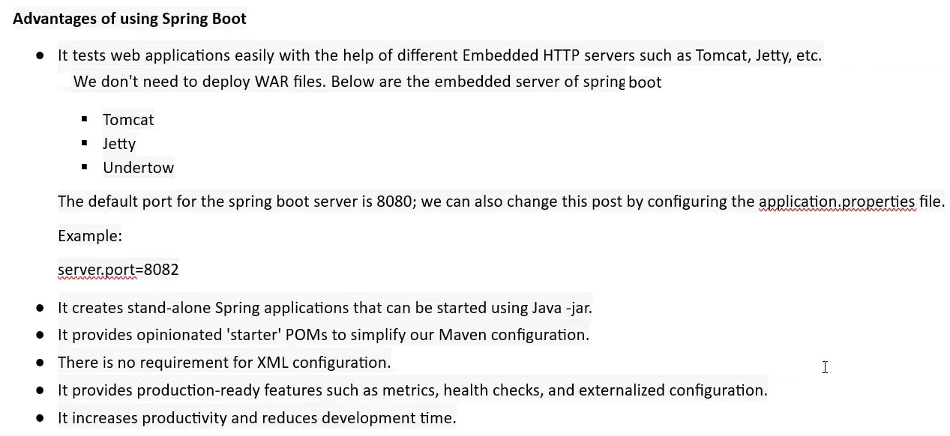

Slide 10
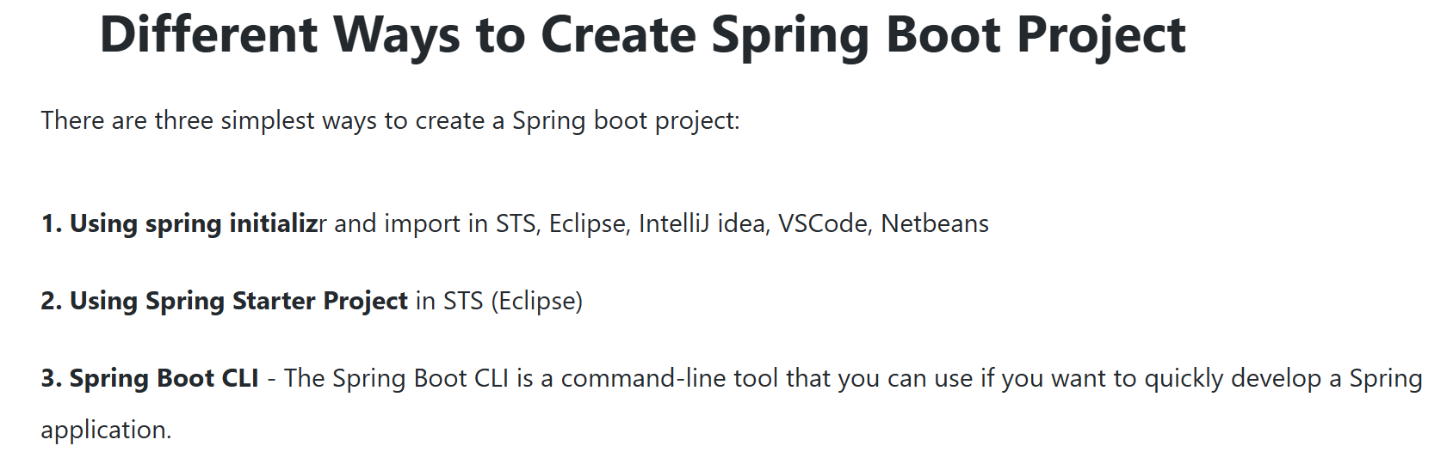

Slide 11
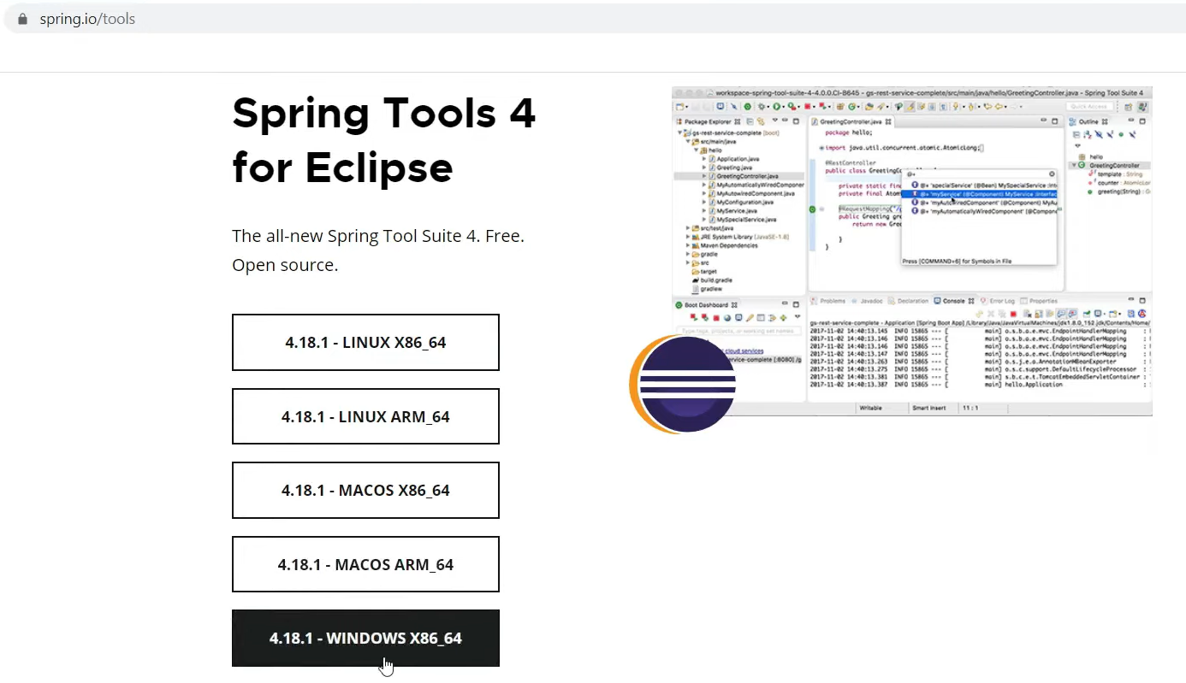

Slide 12
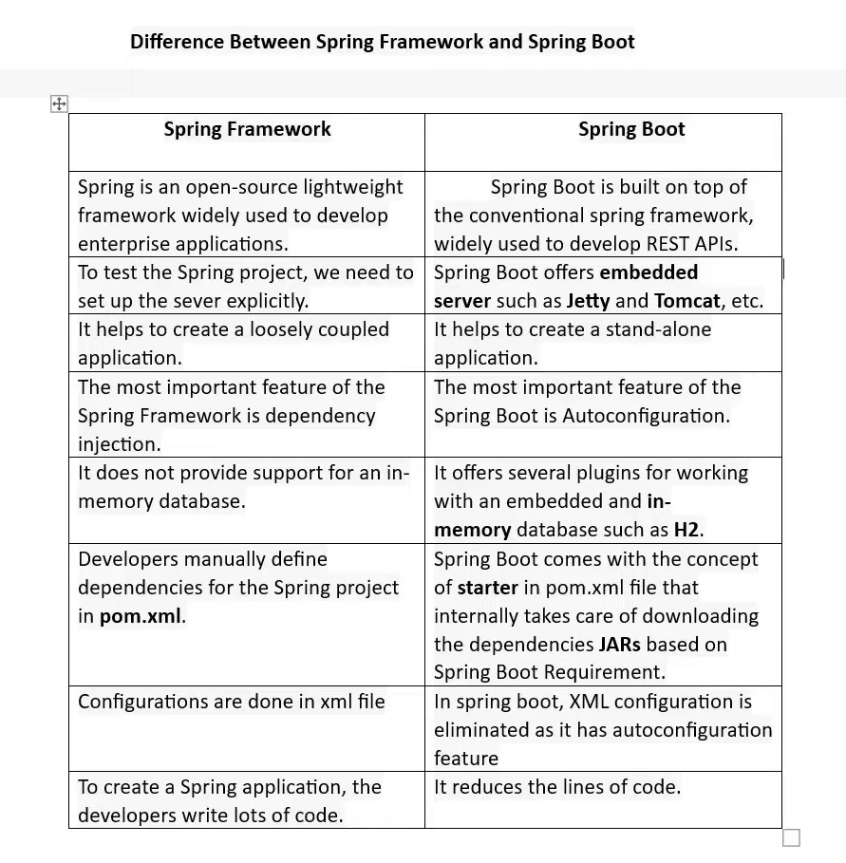

Slide 13
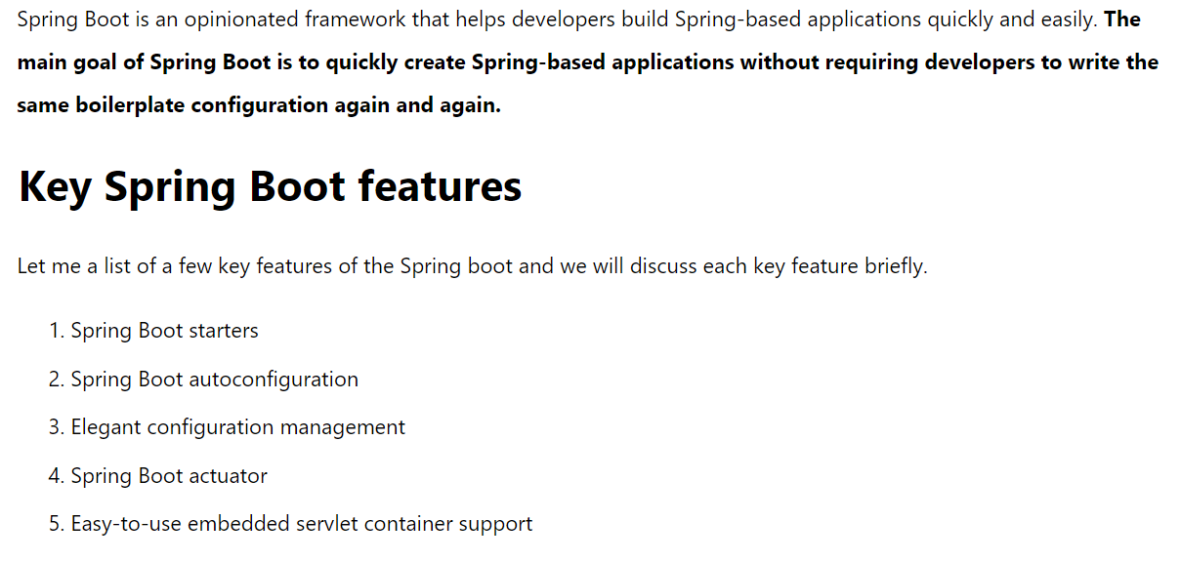

Slide 14
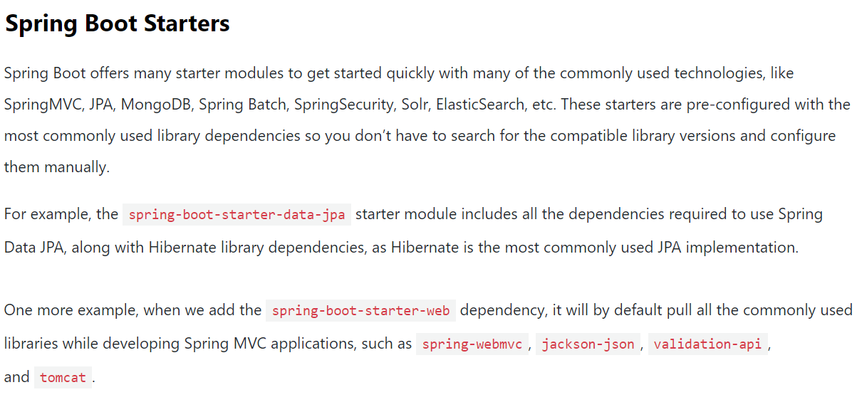

Slide 15
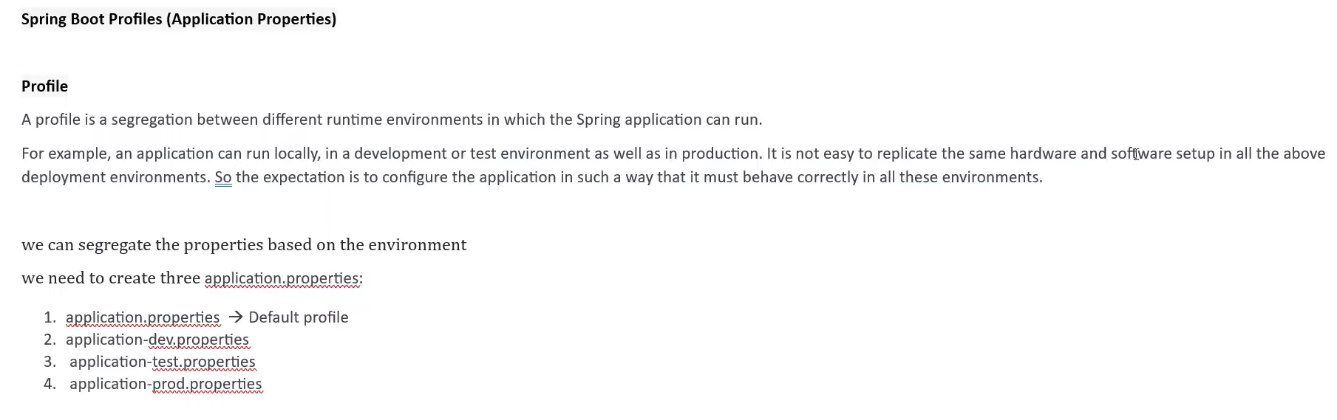

Slide 16
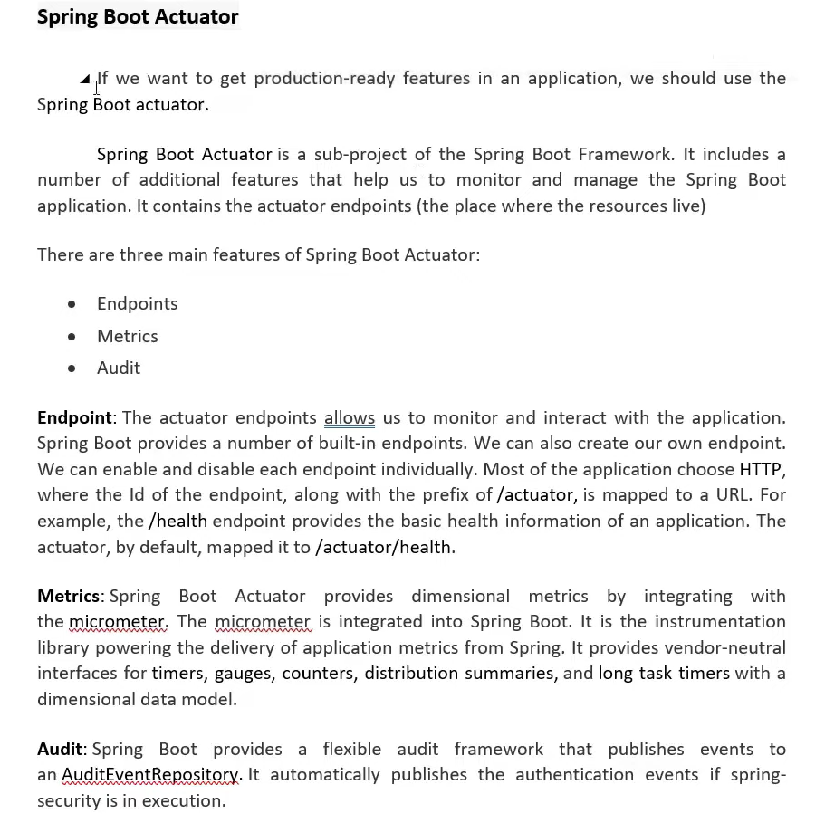

Slide 17
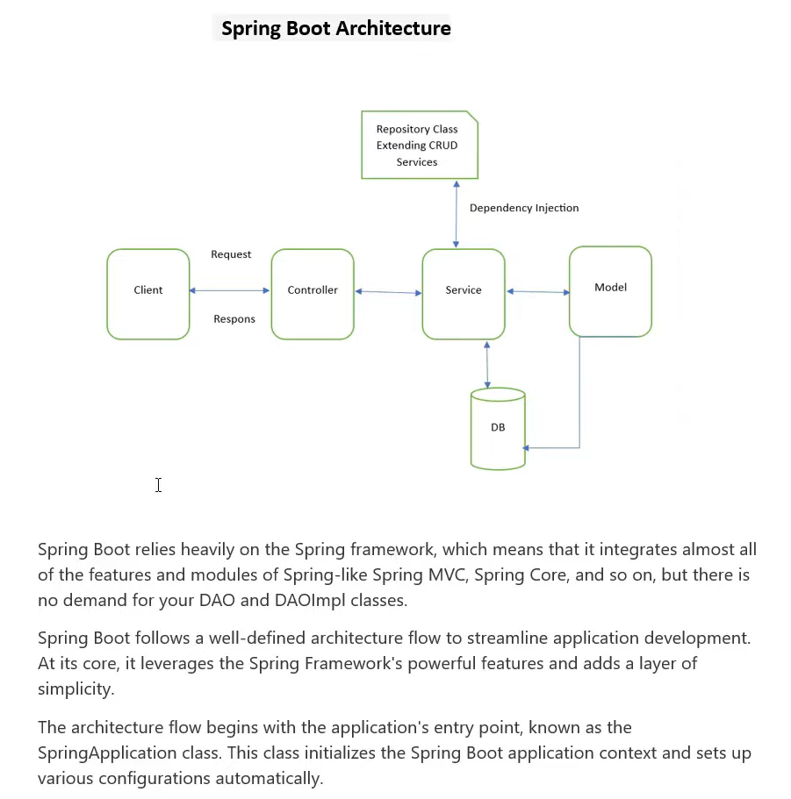

Slide 18
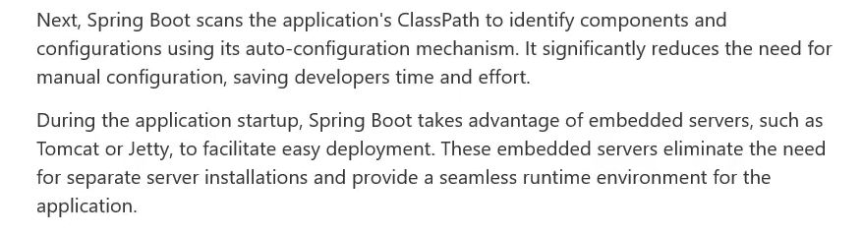

Slide 19
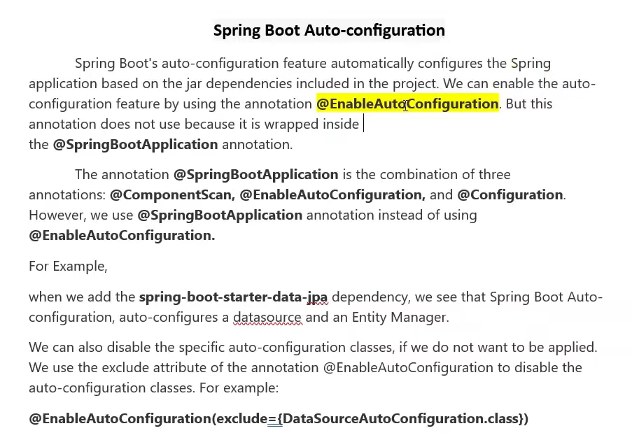

Slide 20
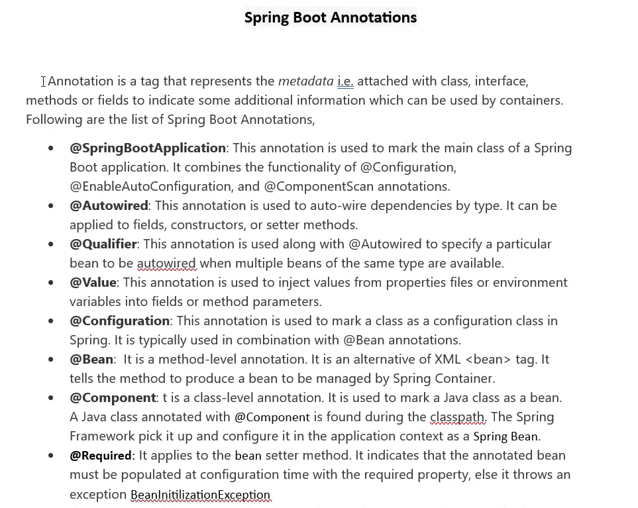

Slide 21
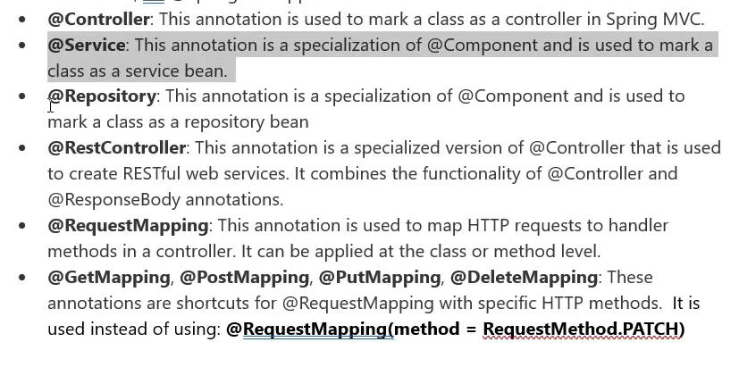

Slide 22
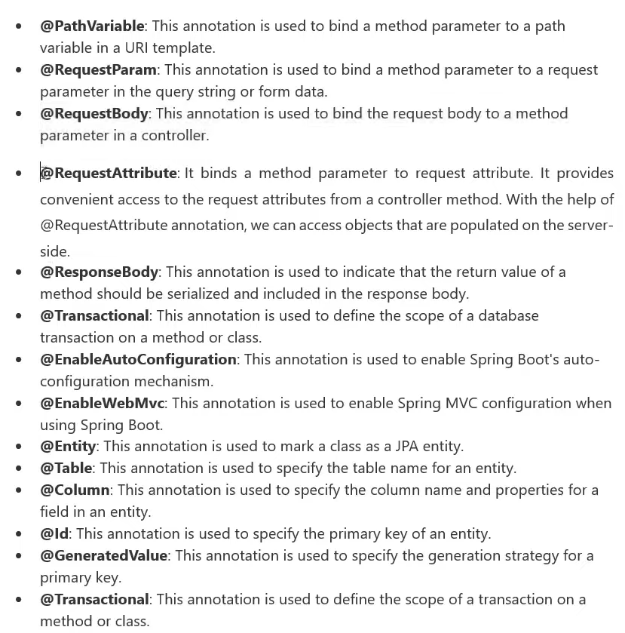

Slide 23
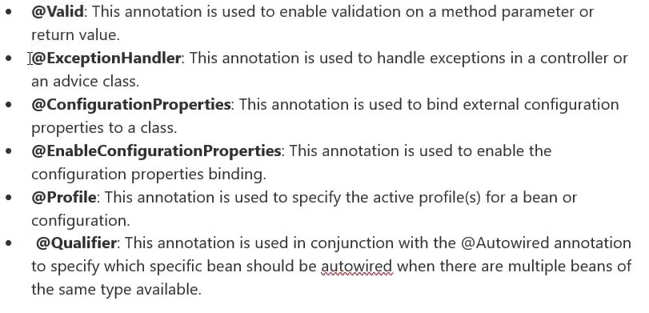

Slide 24
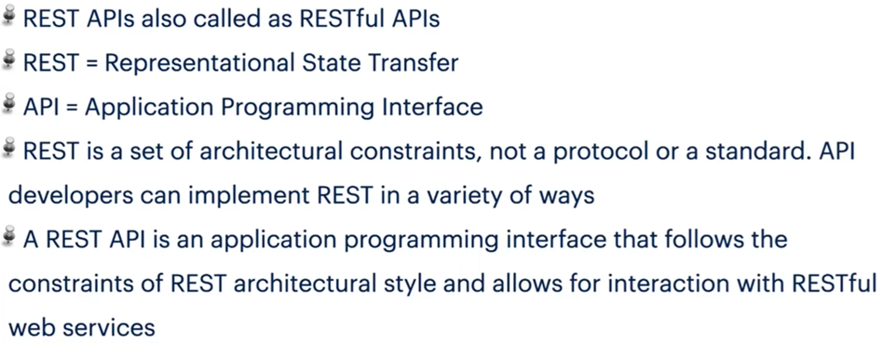

Slide 25
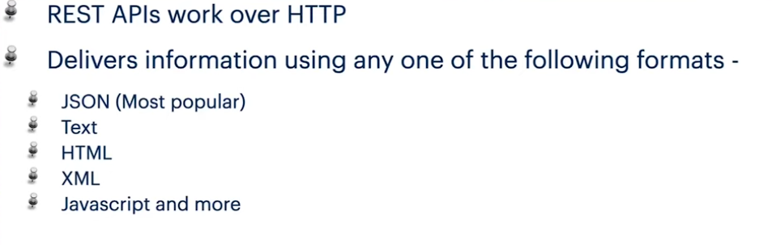

Slide 26
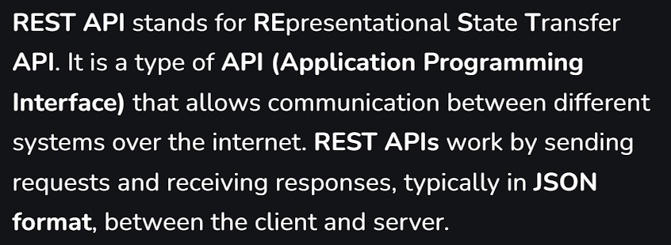

Slide 27
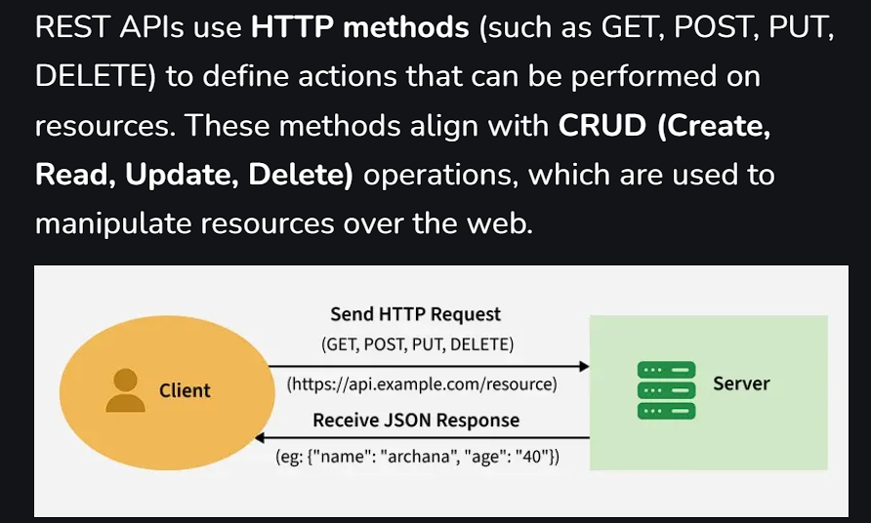

Slide 28
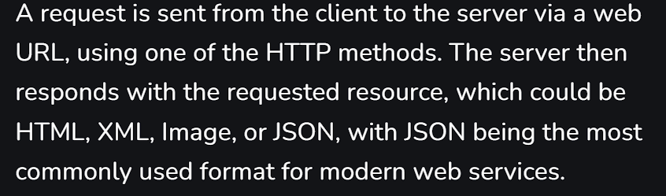

Slide 29
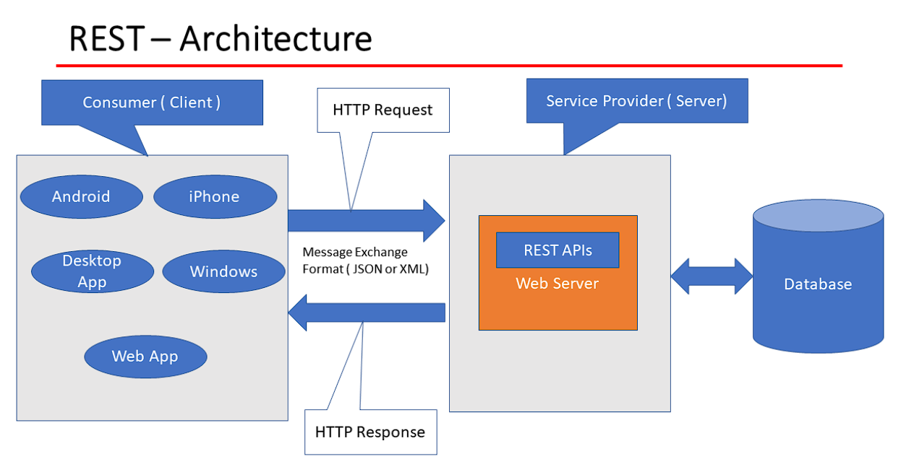

Slide 30
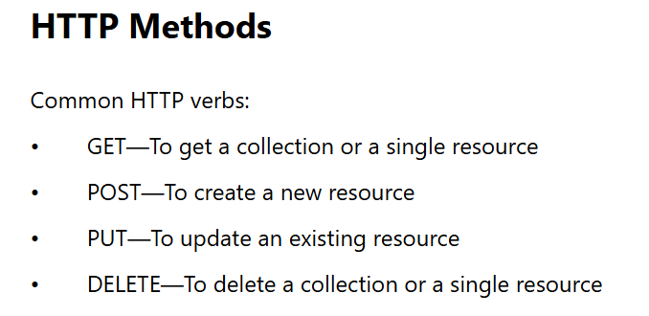

Slide 31
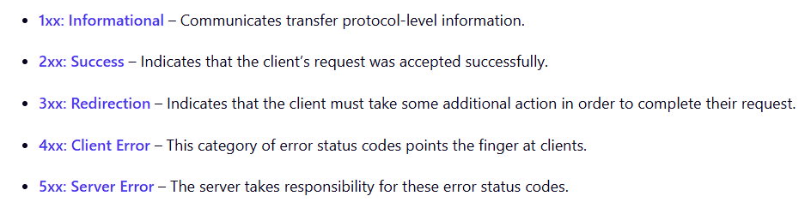

Slide 32
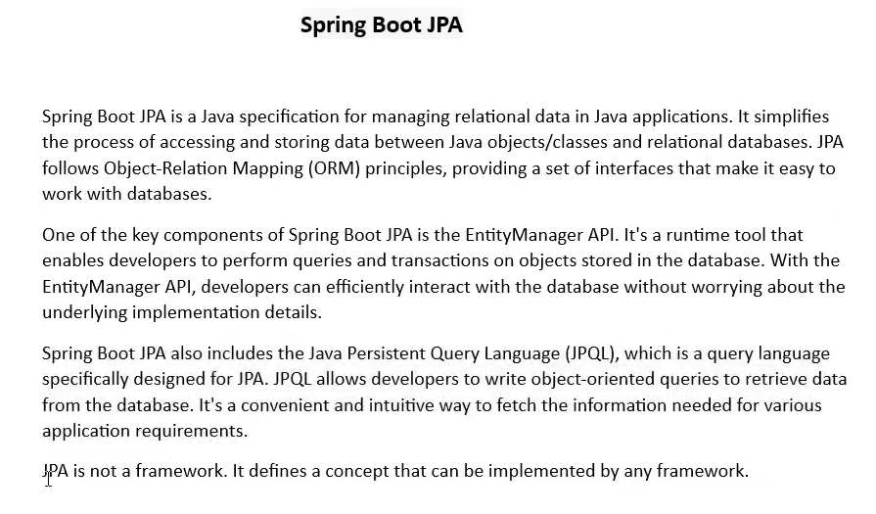

Slide 33
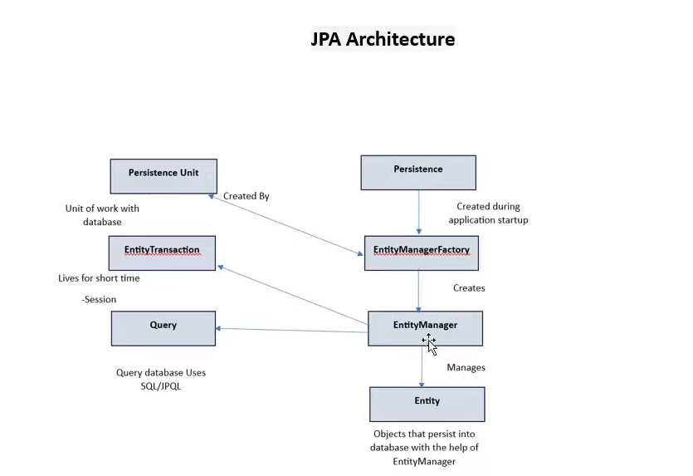

Slide 34
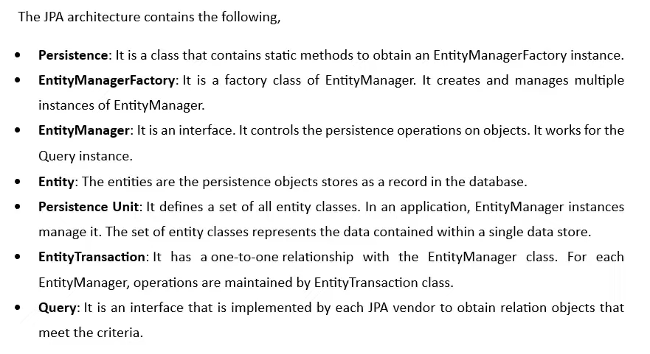

Slide 35
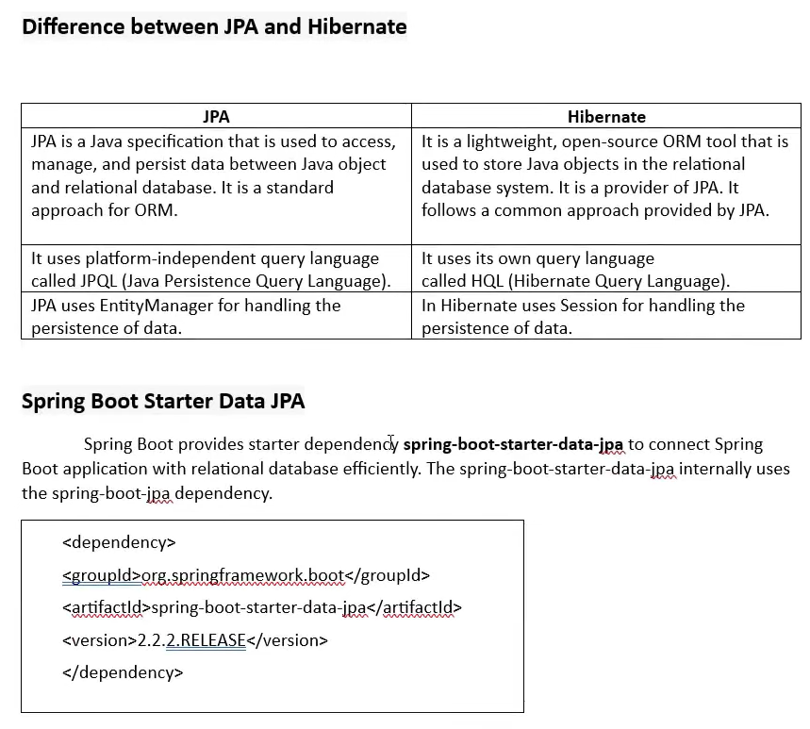

Slide 36
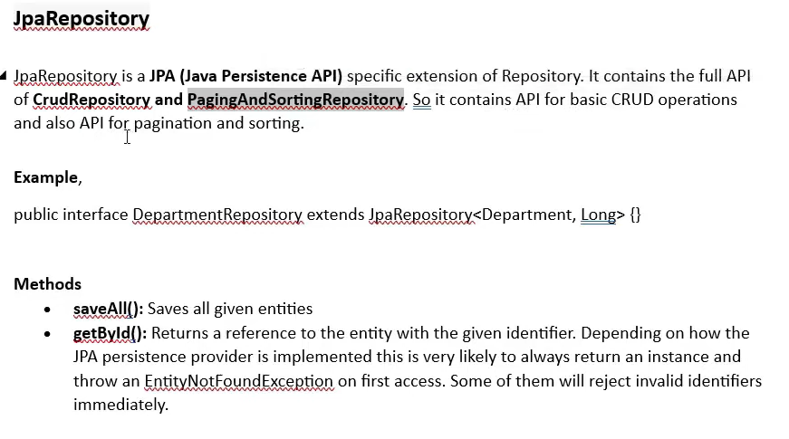

Slide 37
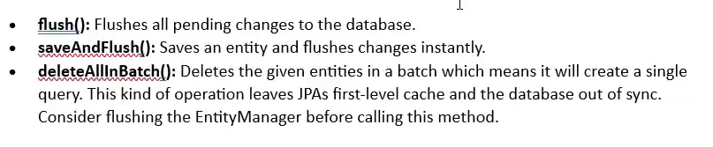

Slide 38
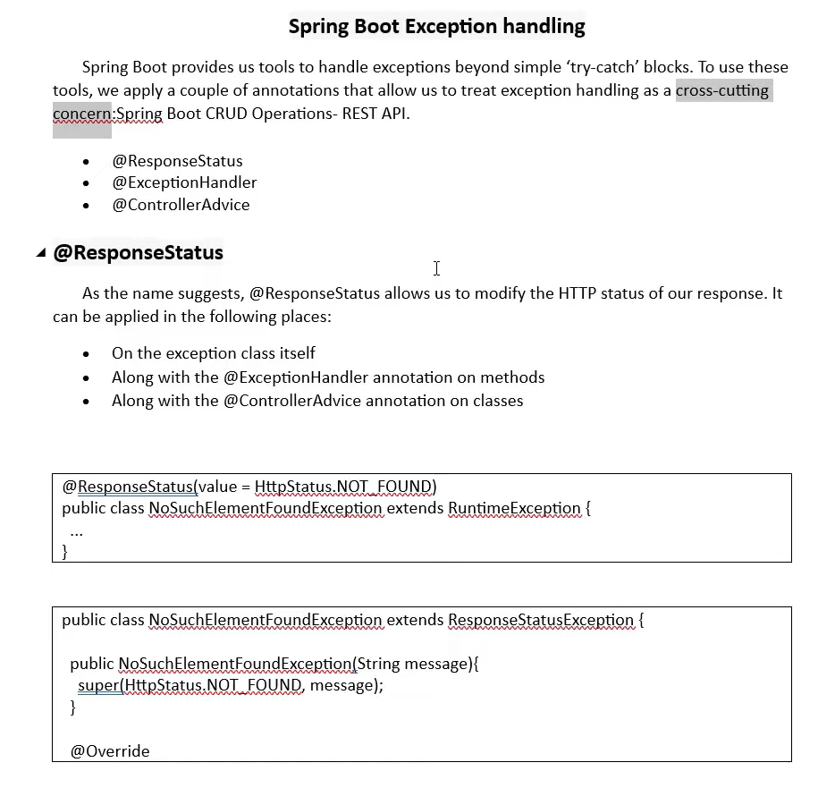

Slide 39
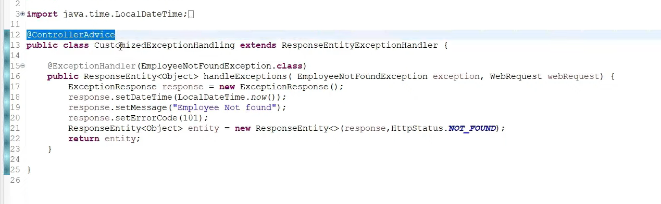

Slide 40
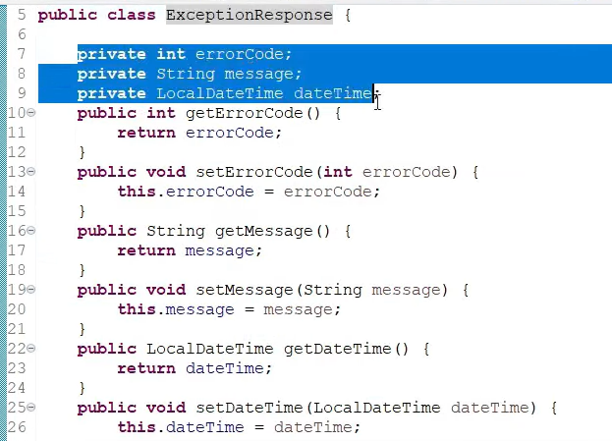

Slide 41
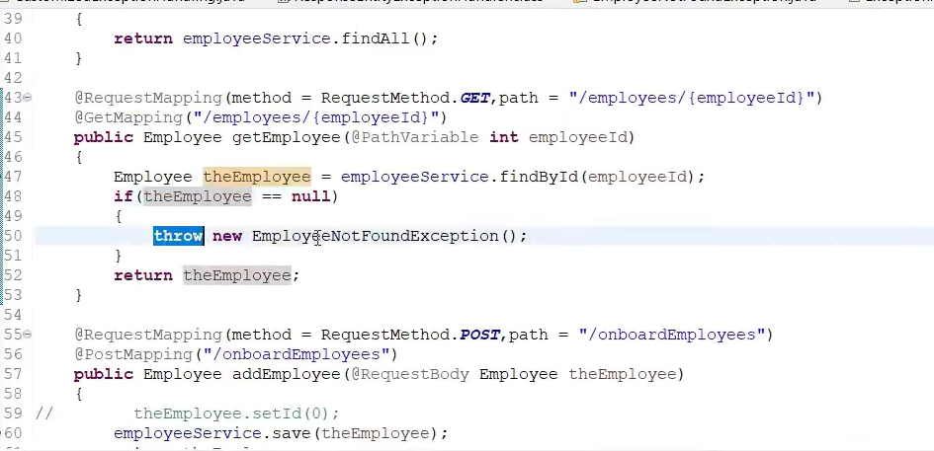

Slide 42
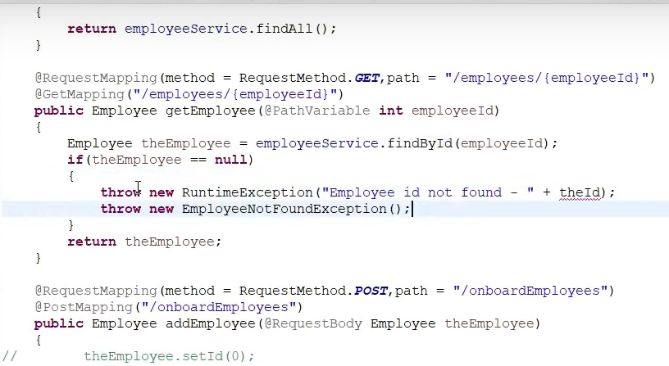

Slide 43
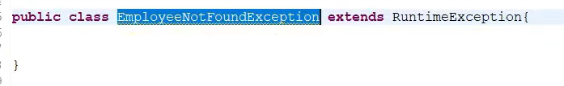
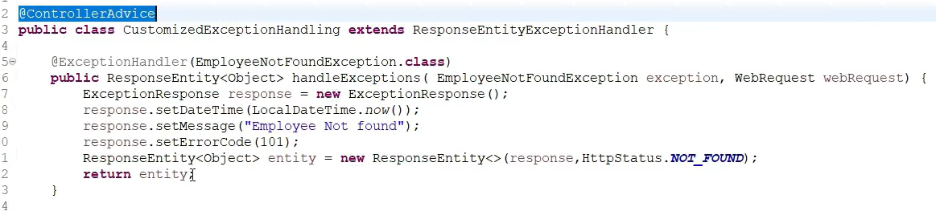

Slide 44
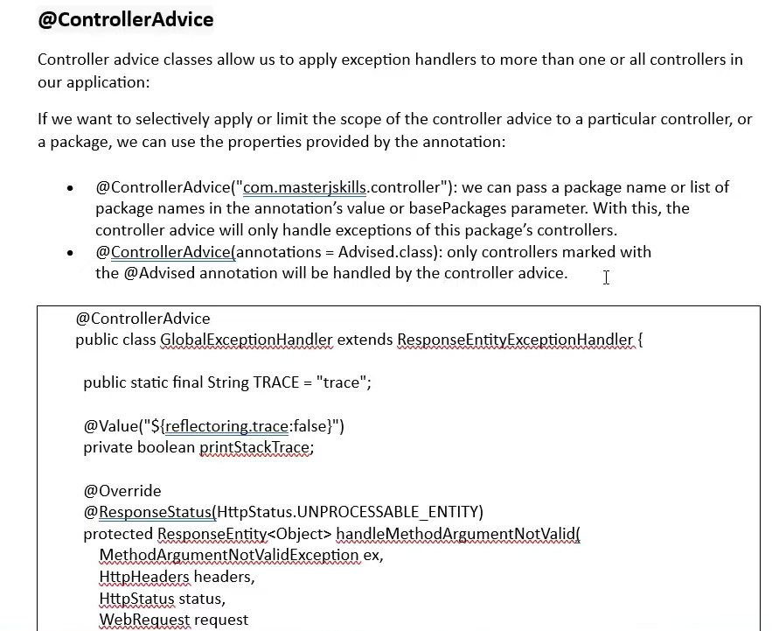

Slide 45
https://medium.com/spring-boot/spring-boot-3-spring-security-6-jwt-authentication-authorization-98702d6313a5

Slide 46
https://github.com/nakeshsingh/microservices
https://www.youtube.com/watch?v=l2eJAMHNdQs&list=PLajapDHA6CyeWFG6hbi8wkdxf76m2mmGZ&index=7

Slide 47
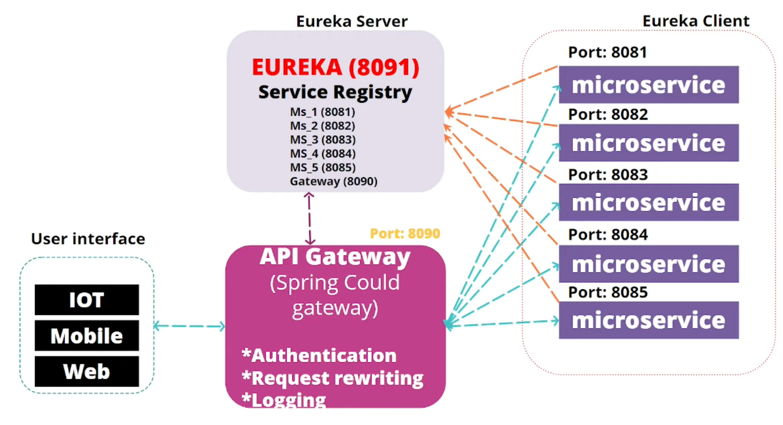

Slide 48
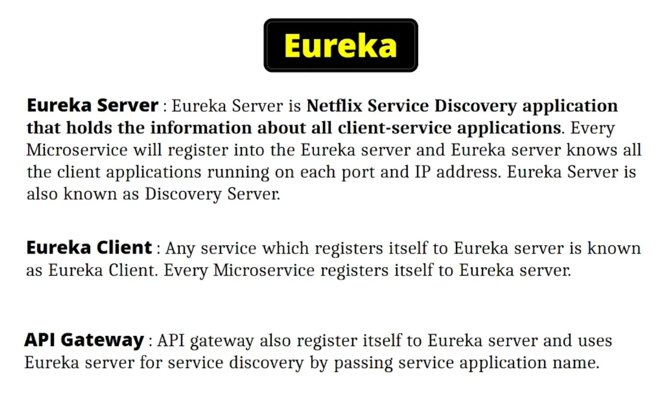

Slide 49
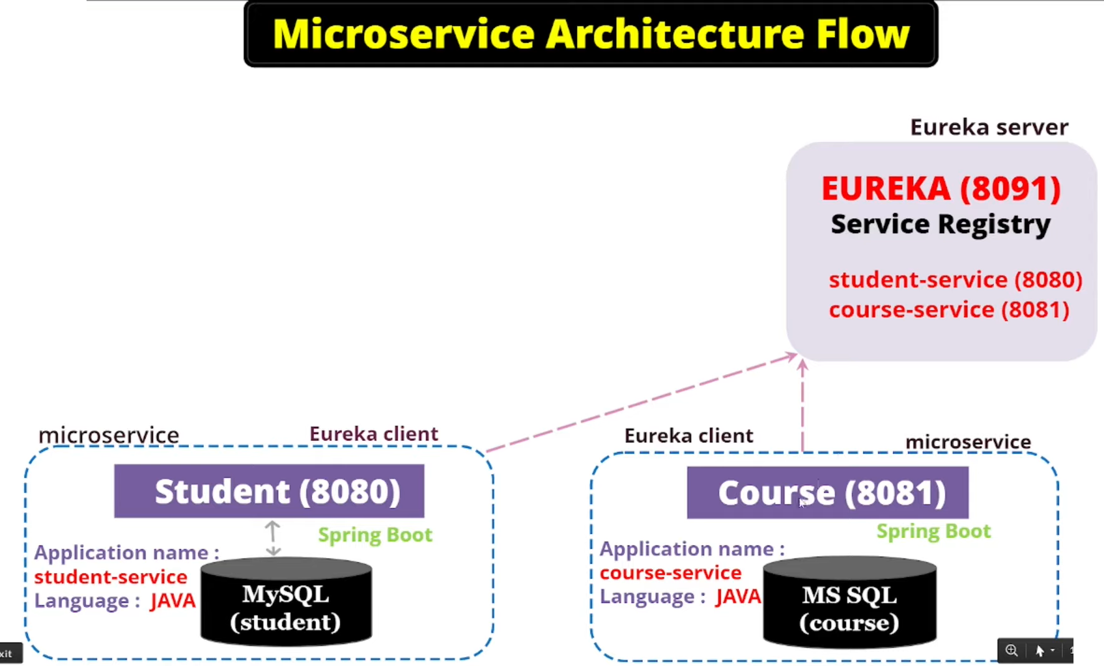

Slide 50
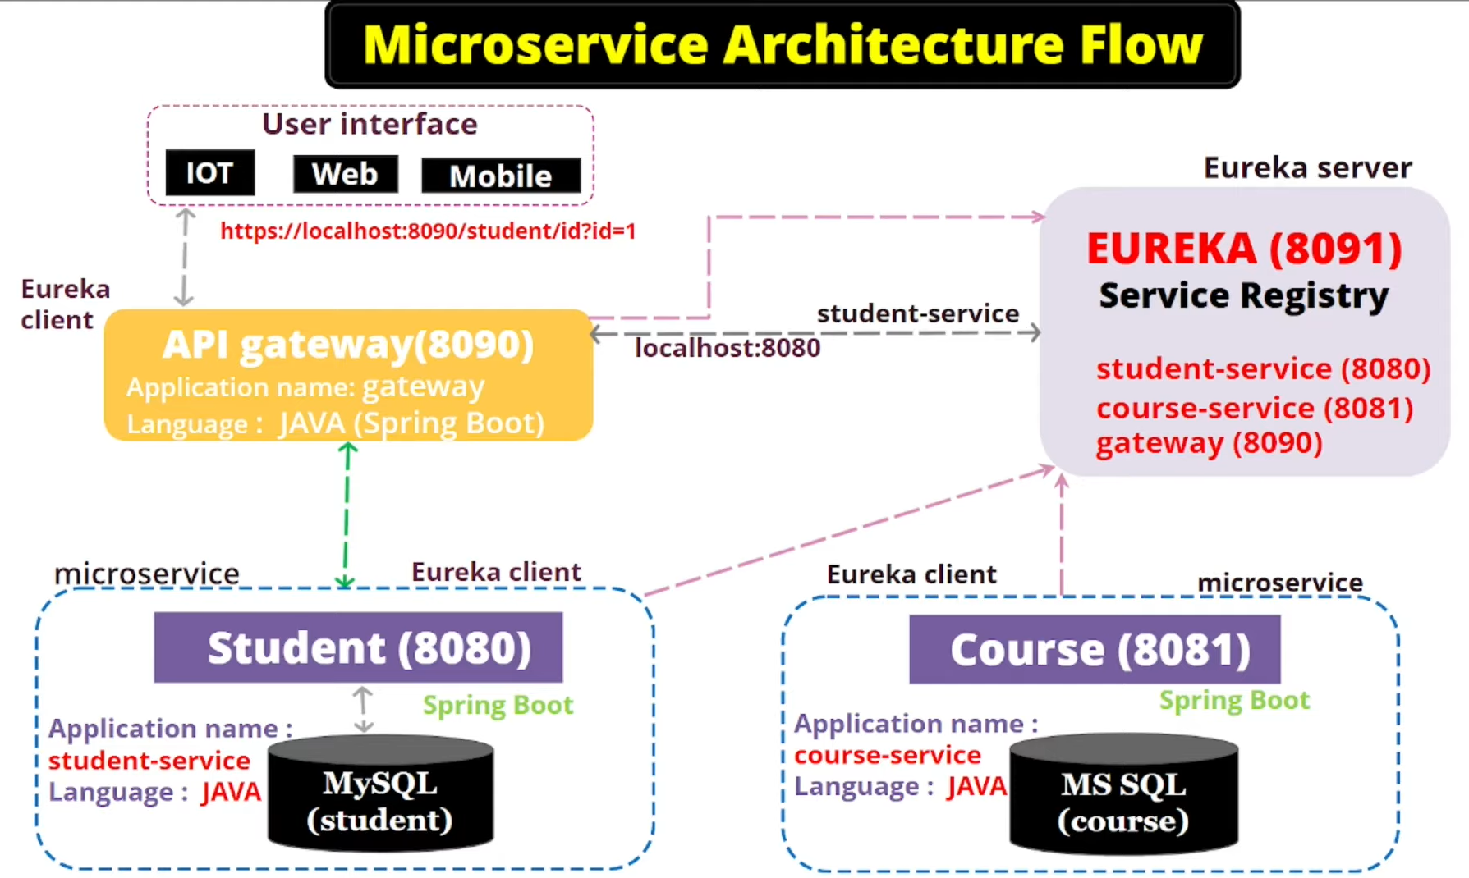

Slide 52
What is Lombok?
Lombok is a Java library that plugs into your IDE and builds tools to automatically generate boilerplate code at compile-time. This means that developers don’t have to write repetitive code for getters, setters, constructors, or logging — Lombok does it for them.

Slide 54
Layers in Spring Boot
Spring Boot follows a layered architecture with the following key layers:
Client Layer:
This represents the external system or user that interacts with the application by sending HTTPS requests.
Controller Layer (Presentation Layer):
Handles incoming HTTP requests from the client.
Processes the request and sends a response.
Delegates business logic processing to the Service Layer.
Service Layer (Business Logic Layer):
Contains business logic and service classes.
Communicates with the Repository Layer to fetch or update data.
Uses Dependency Injection to get required repository services.

Slide 55
Repository Layer (Data Access Layer):
Handles CRUD (Create, Read, Update, Delete) operations on the database.
Extends Spring Data JPA or other persistence mechanisms.
Model Layer (Entity Layer):
Represents database entities and domain models.
Maps to tables in the database using JPA/Spring Data.
Database Layer:
The actual database that stores application data.
Spring Boot interacts with it through JPA/Spring Data.

Slide 56
